Slide 1
Hood River City Council Meeting
February 25, 2019

Slide 2
Intro
Review of Prior Bridge Replacement NEPA work
2017 Oregon Legislature’s Transportation Plan
Environmental Impact Statement Working Group (WG)
Long Term Conceptual Schedule
Conclusion
Notes:
My name is …
- Review of Prior Bridge Replacement NEPA work
- 2017 Oregon Legislature’s Transportation Plan
- NEPA Working Group
- Long Term Conceptual Schedule
- Conclusion

Slide 3
Review of Prior NEPA Work (1999-2010)
Notes:
Describe the National Environmental Protection Act (NEPA). 1972
Working began in 1999 back in the day of earmarks through Washington state congressional earmarks funneled through the SW Wash. Regional Transportation Council (RTC)
A Draft Environmental Impact Statement (DEIS) was completed in 2003)
Feasibility Study in 2004

Slide 4
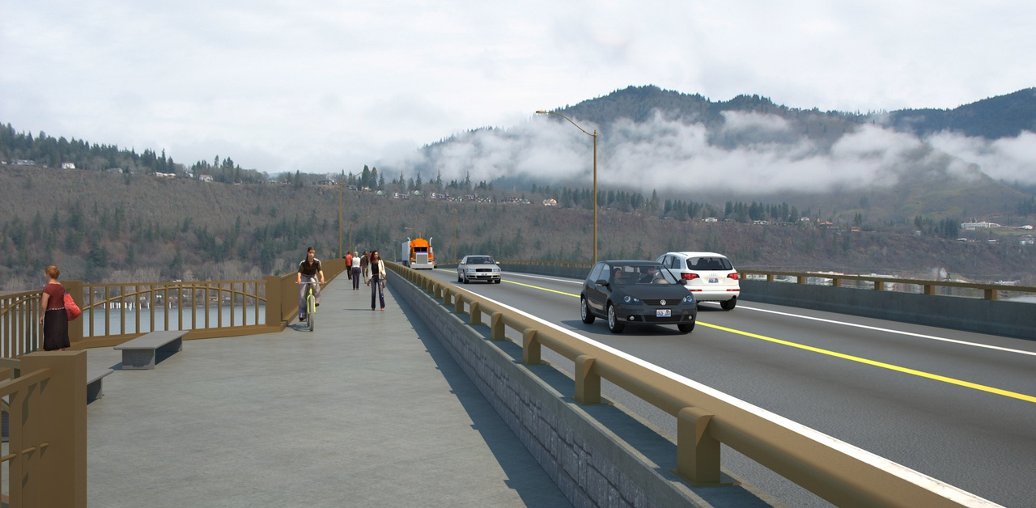
Preliminary Preferred Alternative (2011)
Notes:
Removes lift span and increases vertical clearance to 80’
12’ pedestrian/bike lane on west side of bridge with viewing points.
Addition of storm water collection system.
Two 12’ travel lanes; 8’ shoulders
NSA design elements

Slide 5
2017 Oregon Transportation Bill
HB2750 – P3 Rules
Allows for Public Private Partnerships (P3s) to be considered
Requires administrative rules to be developed
Rules completed June 5, 2018
HB2017 - $5M NEPA Completion
With the assistance of State Sen. Chuck Thomsen, the Port received a significant appropriation to complete the NEPA Process
A bi-state evaluation committee scored NEPA proposals and recommended selection of WSP USA Inc..
WSP began work in August on a 30-month contract to complete the NEPA process by December 2020.
The Final EIS/Record of Decision (ROD) clears the project for federal funding and authority, but does not include permits or significant engineering.
Notes:
HB2750 P3 Rules
Rules are administrative in nature
Created in case a P3 is warranted
Actual criteria and details of a P3 would be developed at a later time once financing has been studied
HB2017 –
Picks up where RTC funding ended in 2011

Slide 6
Environmental Review Process Schedule
Notes:
Discuss NEPA process being focused on transparency
Opportunities for public involvement

Slide 7
EIS Working Group (EISWG)
MEMBERS
Hood River County, Rich McBride
Klickitat County, Rex Johnston
City of Hood River, open
City of White Salmon, David Poucher
City of Bingen, Betty Barnes
Col. River Gorge Commission, Lorrie deKay
Port of Klickitat, Wayne Vinyard
Port of Hood River, Brian Shortt
ACT Reg. 1, Jon Davies
SW RTC, Matt Ransom
THE EISWG WILL…
Receive information from NEPA consultants
Review prior studies
Engineering assumptions
Project timelines and budgets
Review needed permits
Mitigation Requirements
Provide feedback loop between consultants and constituents
Will not be discussing the future operation and control of the bridge or setting tolls for a future bridge
Next meeting: Thurs., Feb. 21, 4-6pm, White Salmon
Notes:
EIS WG is one of several community engagement strategies.
Will meet about once a quarter.
Feedback loop
Charter is on the WG’s webpage / general agendas have been projected through the end of the project December 2020
Next meeting is Feb. 21 in White Salmon 4-6

Slide 8
Long Term Conceptual Schedule
Notes:
PHASE 2
Financial Plan
Evaluate Ownership
Develop Governance Structure
Level 2 Traffic & Revenue (T&R) Study
BUDGET: $20M (with Phase 3 & 4)
DURATION: 24 months
PHASE 3
Governance Established
Oregon/Washington State Legislation Pursued
Level 3 T&R Study
Grant/Loan Applications Submitted
BUDGET: $20M (with Phase 2 & 4)
DURATION: 18 months
PHASE 4
Finalize Permits
Finalize Engineering
Pre-Construction Contract
Establish New Toll Structure
BUDGET: $20M (with Phase 2 & 3)
DURATION: 15 months
PHASE 5
Risk Spread Amongst Partners
Operations & Maintenance Plan Developed
Construction Contract Awarded and Managed
BUDGET: $260M
DURATION: 39 months

Slide 9
Thank you!
Kevin Greenwood
Bridge Replacement Project Director
Port of Hood River
kgreenwood@portofhoodriver.com
(541) 436-0797

