Slide 1
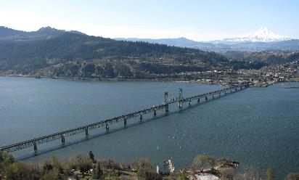
Section 106 Consulting Party Meeting
July 14, 2021

Slide 2
Agenda
Introductions: Project Partners Roll Call
Project Updates: Status of NEPA process (SDEIS (timetable))
Project Updates: Section 106
Consulting party updates
Concurrences received from Oregon SHPO and Washington DAHP on eligibility and overall project effects
Adverse Effect to the Hood River – White Salmon Interstate Bridge
Status of Archaeological Resources Survey Report & Archaeological Testing Report
Group discussion on which mitigation options to pursue further
Review Schedule of Project Agreement and agreement component reviews
Summary of next steps, action items, and next meeting date

Slide 3
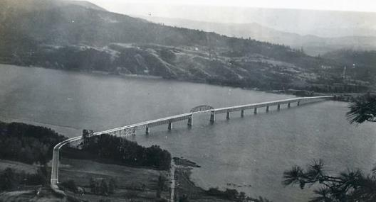
Section 106 Agencies, Tribes, and Other Consulting Parties
Federal Highway Administration
U.S. Coast Guard
U.S. Army Corps of Engineers
U.S. Bureau of Indian Affairs
Oregon DOT
Washington State DOT
USDA-CRG National Scenic Area
Oregon SHPO
Washington State DAHP
Port of Hood River
Notes:
The overall purpose of the Project is to improve the movement of people and goods across the Columbia River between the White Salmon and Hood River communities with the identified need of improving current and future transportation inadequacies and deficiencies associated with the existing Hood River Bridge. Specifically, the Project addresses the following needs:
Roadway capacity: Address traffic congestion on the bridge and at both approaches.
System linkages: Maintain a cross-river connection.
Transportation demand: Meet future travel demand for vehicles, pedestrians, and bicycles.
Legislation: Comply with state and federal laws for the corridor.
Social demands/economic development: Provide for current and projected flow of goods, labor, and consumers across the river; develop long-term funding strategies for operation and maintenance.
Modal interrelationships: Accommodate river navigation, passenger and commercial vehicles, transit, bicycles, and pedestrians.
Safe travel for all modes, including river navigation
Roadway and bridge deficiencies: Resolve height, weight, and width deficiencies of the bridge; reduce audible noise associated with bridge deck travel; and meet current seismic design standards.

Slide 4
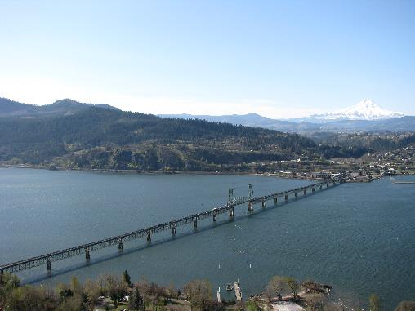
Section 106 Agencies, Tribes, and Other Consulting Parties
Confederated Tribes of the Umatilla Indian Reservation
Confederated Tribes of the Warm Springs Reservation of Oregon
Confederated Tribes and Bands of the Yakama Nation
Nez Perce Tribe
Confederated Tribes of the Grand Ronde Community of Oregon
Confederated Tribes of Siletz Indians
Cowlitz Indian Tribe
Notes:
The overall purpose of the Project is to improve the movement of people and goods across the Columbia River between the White Salmon and Hood River communities with the identified need of improving current and future transportation inadequacies and deficiencies associated with the existing Hood River Bridge. Specifically, the Project addresses the following needs:
Roadway capacity: Address traffic congestion on the bridge and at both approaches.
System linkages: Maintain a cross-river connection.
Transportation demand: Meet future travel demand for vehicles, pedestrians, and bicycles.
Legislation: Comply with state and federal laws for the corridor.
Social demands/economic development: Provide for current and projected flow of goods, labor, and consumers across the river; develop long-term funding strategies for operation and maintenance.
Modal interrelationships: Accommodate river navigation, passenger and commercial vehicles, transit, bicycles, and pedestrians.
Safe travel for all modes, including river navigation
Roadway and bridge deficiencies: Resolve height, weight, and width deficiencies of the bridge; reduce audible noise associated with bridge deck travel; and meet current seismic design standards.

Slide 5
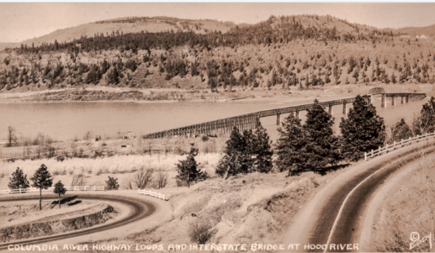
Section 106 Agencies, Tribes, and Other Consulting Parties (CPs)
Columbia River Inter-Tribal Fish Commission
City of Hood River
City of White Salmon
Klickitat County
Hood River County
Historic Columbia River Highway Advisory Committee
History Museum of Hood River County
City of Hood River Landmarks Review Board
Klickitat County Historical Society
Gorge Heritage Museum/Western Klickitat County Historical Society
Washington Trust for Historic Preservation
Notes:
The overall purpose of the Project is to improve the movement of people and goods across the Columbia River between the White Salmon and Hood River communities with the identified need of improving current and future transportation inadequacies and deficiencies associated with the existing Hood River Bridge. Specifically, the Project addresses the following needs:
Roadway capacity: Address traffic congestion on the bridge and at both approaches.
System linkages: Maintain a cross-river connection.
Transportation demand: Meet future travel demand for vehicles, pedestrians, and bicycles.
Legislation: Comply with state and federal laws for the corridor.
Social demands/economic development: Provide for current and projected flow of goods, labor, and consumers across the river; develop long-term funding strategies for operation and maintenance.
Modal interrelationships: Accommodate river navigation, passenger and commercial vehicles, transit, bicycles, and pedestrians.
Safe travel for all modes, including river navigation
Roadway and bridge deficiencies: Resolve height, weight, and width deficiencies of the bridge; reduce audible noise associated with bridge deck travel; and meet current seismic design standards.

Slide 6
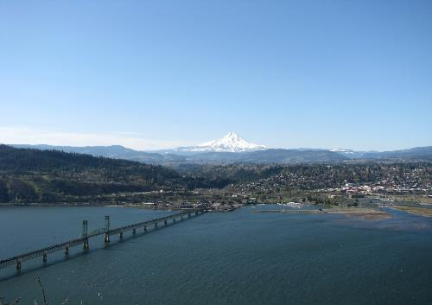
Project Updates
Consulting Party Updates
Repository for Feasibility Study & 2003 Draft EIS:
https://www.rtc.wa.gov/studies/sr35/
Publishing of Supplemental DEIS (Comments were due by January 4, 2021)
https://portofhoodriver.com/bridge/bridge-replacement-project/
Combined Final EIS & Record of Decision – December 2021
Notes:
The map on the right shows the location of the three alternatives with alternative EC-1 in green, preferred alternative EC-2 in orange, and Alternative EC-3 in blue

Slide 7
Status of Consultation
Section 106 Consultation 2019-2021
April 2019 – FHWA distributes invitations to Section 106 consultation
July 9, 2019 – APE letter from ODOT to SHPOs
July 15, 2019 – DAHP concurs w/ APE
July 15, 2019 – OR SHPO concurs w/APE
Oct. 2020 - Submittal of Preliminary/Draft Baseline and Built Environment reports to DAHP
October 21, 2020 – DAHP response w/ comments to be addressed (both archaeology and built env.)
October 28, 2020 – OR SHPO response w/ comments to be addressed
November 12, 2020 – OR SHPO response w/ comments to be addressed (built env.)
DAHP and Oregon SHPO concur with eligibility and effect findings (April 7, 2021; July 9, 2021)
Notes:
The overall purpose of the Project is to improve the movement of people and goods across the Columbia River between the White Salmon and Hood River communities with the identified need of improving current and future transportation inadequacies and deficiencies associated with the existing Hood River Bridge. Specifically, the Project addresses the following needs:
Present transportation capacity: Address traffic congestion on the bridge and at both approaches.
Future Transportation demand: Meet future travel demand for vehicles, pedestrians, and bicycles.
Bicycle and pedestrian facilities:
Social demands/economic development: Provide for current and projected flow of goods, labor, and consumers across the river; develop long-term funding strategies for operation and maintenance.
Legislation: Comply with state and federal laws for the corridor.
River Navigation – fixed bridge structure Accommodate river navigation, passenger and commercial vehicles, transit, bicycles, and pedestrians.
Seismic deficiencies: Resolve height, weight, and width deficiencies of the bridge; meet current seismic design standards.

Slide 8
Status of Consultation
Section 106 Consultation 2019-2021
Archaeological Resources Survey Report & Archaeological Testing Report distributed to OR SHPO, DAHP, & Tribes on June 22, 2021
Comments due July 23, 2021
Roy Watters (ODOT) to follow up individually with OR SHPO, DAHP, & Tribes
Notes:
The overall purpose of the Project is to improve the movement of people and goods across the Columbia River between the White Salmon and Hood River communities with the identified need of improving current and future transportation inadequacies and deficiencies associated with the existing Hood River Bridge. Specifically, the Project addresses the following needs:
Present transportation capacity: Address traffic congestion on the bridge and at both approaches.
Future Transportation demand: Meet future travel demand for vehicles, pedestrians, and bicycles.
Bicycle and pedestrian facilities:
Social demands/economic development: Provide for current and projected flow of goods, labor, and consumers across the river; develop long-term funding strategies for operation and maintenance.
Legislation: Comply with state and federal laws for the corridor.
River Navigation – fixed bridge structure Accommodate river navigation, passenger and commercial vehicles, transit, bicycles, and pedestrians.
Seismic deficiencies: Resolve height, weight, and width deficiencies of the bridge; meet current seismic design standards.

Slide 9
Existing and Future Conditions
Existing
Future
Notes:
Kevin:
Here is a visual representation of the existing bridge and future bridge.
Speak to key differences:
Higher profile
Fixed structure

Slide 10
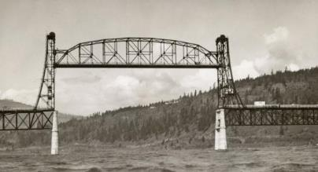
Project Agreement Consultation Schedule (Accomplished)
Tribal Project Section 106 Preview Meeting: November 2, 2020 (Completed)
Agency Project Section 106 Preview Meeting: November 4, 2020 (Completed)
Section 106 Consultation Meeting: November 17, 2020 (Completed)
Section 106 Consultation Meeting: December 7, 2020 (Completed)
Section 106 Consultation Meeting: January, 2021 (Postponed)
Section 106 Consultation Meeting: July 14, 2021 (Today)
Notes:
Image: Gears from the 1931 bridge incorporated into pedestrian railing of the new South Park Bridge. The bridge also recreates appearance of the original.

Slide 11
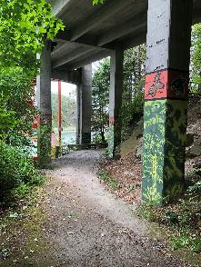
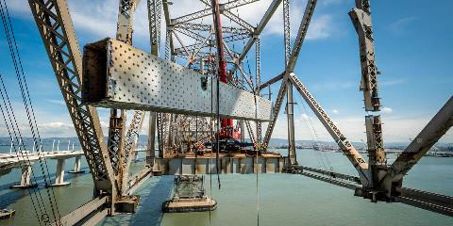
Project Agreement for Adverse Effect to the Hood River – White Salmon Interstate Bridge
Rainbow Bridge, La Connor, WA
Exploring Potential Mitigation Options
Adaptations to bridge design
Use of historic bridge components in the new design
Historic American Engineering Record (HAER)
Interpretive panels
Creation of a museum exhibit
Documentation of Columbia River crossings
SF Bay Bridge, Oakland, CA
Notes:
Image: Gears from the 1931 bridge incorporated into pedestrian railing of the new South Park Bridge. The bridge also recreates appearance of the original.

Slide 12
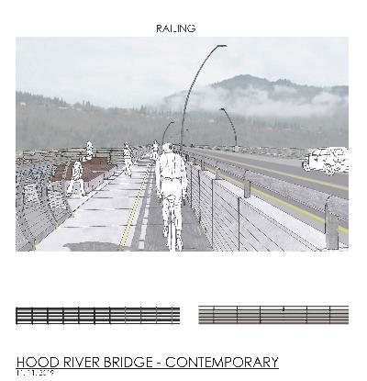
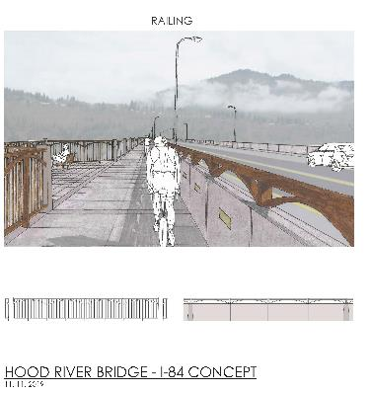
Adaptations to Bridge Design
Notes:
Image: Gears from the 1931 bridge incorporated into pedestrian railing of the new South Park Bridge. The bridge also recreates appearance of the original.

Slide 13
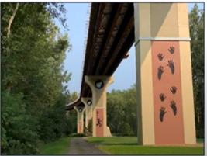
Adaptations to Bridge Design: Art/Cultural Expressions
Rainbow Bridge, La Connor, WA
Ohio Example
Notes:
Image: Gears from the 1931 bridge incorporated into pedestrian railing of the new South Park Bridge. The bridge also recreates appearance of the original.

Slide 14
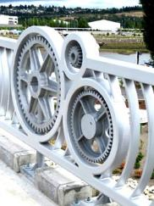
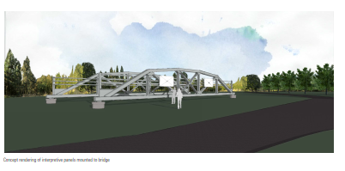
Use of Historic Bridge Components
State Highway 79 Truss Bridge, Oklahoma
South Park Bridge, Seattle, WA
Notes:
Image: Gears from the 1931 bridge incorporated into pedestrian railing of the new South Park Bridge. The bridge also recreates appearance of the original.

Slide 15
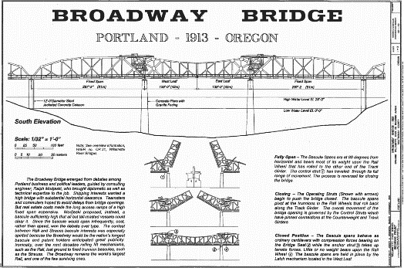
Historic American Engineering Record
Broadway Bridge, Portland, Oregon
Notes:
Image: Gears from the 1931 bridge incorporated into pedestrian railing of the new South Park Bridge. The bridge also recreates appearance of the original.

Slide 16
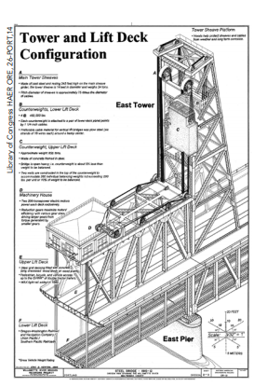
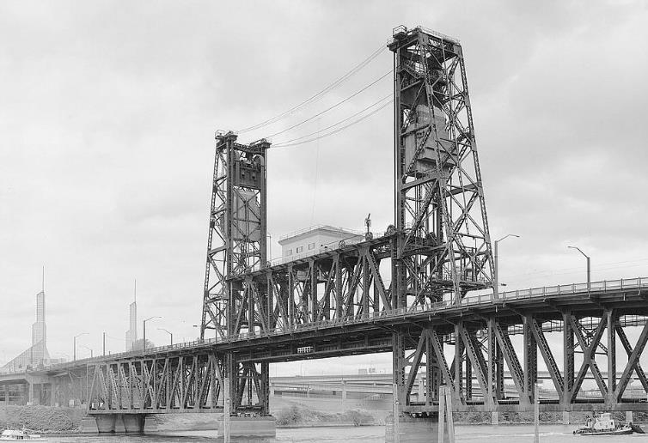
Historic American Engineering Record
Steel Bridge, Portland, Oregon
Notes:
Image: Gears from the 1931 bridge incorporated into pedestrian railing of the new South Park Bridge. The bridge also recreates appearance of the original.

Slide 17
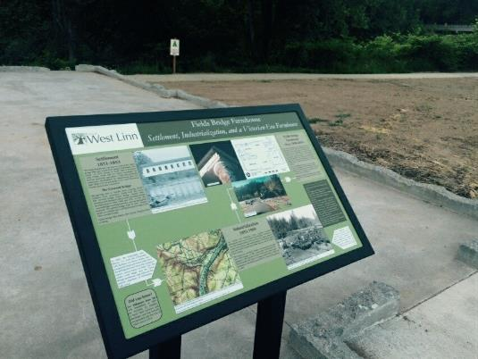
Interpretive Panels (Locations & Content)
Notes:
Image: Gears from the 1931 bridge incorporated into pedestrian railing of the new South Park Bridge. The bridge also recreates appearance of the original.

Slide 18
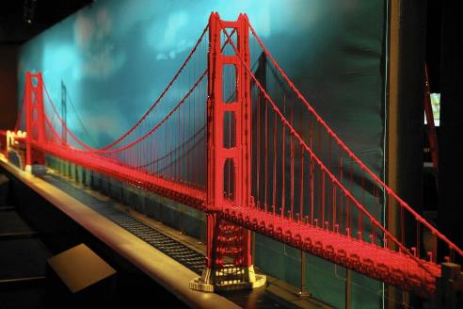
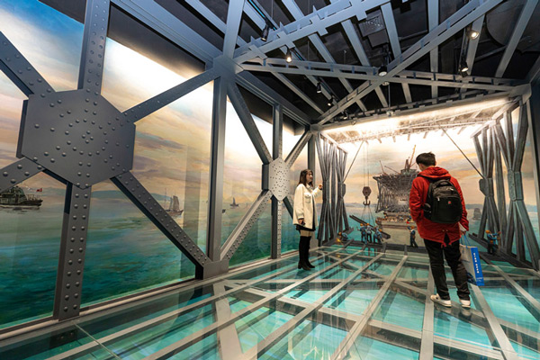
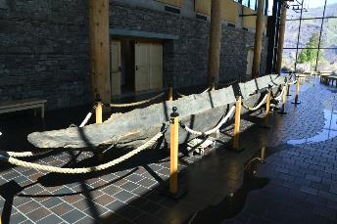
Museum Exhibits
Lego Model of Golden Gate Bridge, Chicago Museum of Science & Industry
Historic Bridge Museum, China
Dugout Canoe, CGDCM
Notes:
Image: Gears from the 1931 bridge incorporated into pedestrian railing of the new South Park Bridge. The bridge also recreates appearance of the original.

Slide 19
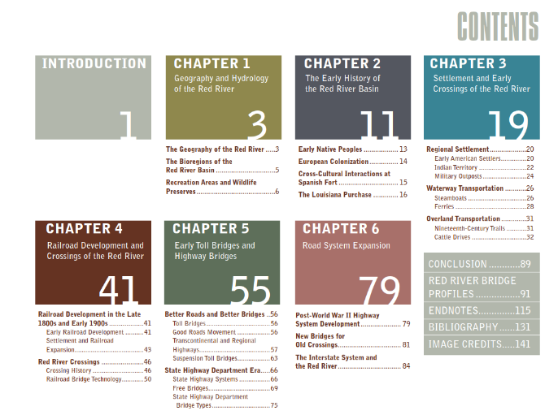
Documentation/Publication of Columbia River Crossings
Notes:
Image: Gears from the 1931 bridge incorporated into pedestrian railing of the new South Park Bridge. The bridge also recreates appearance of the original.

Slide 20
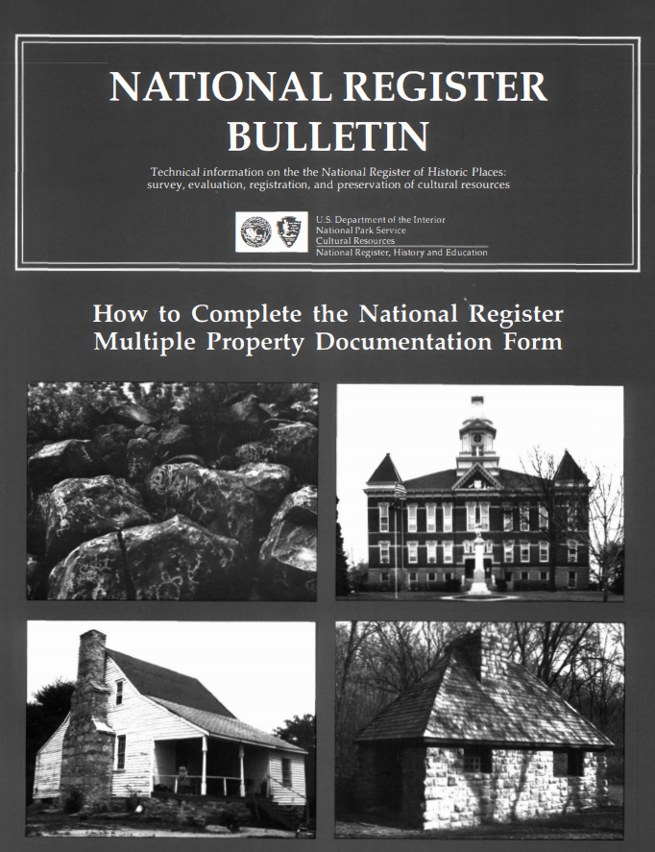
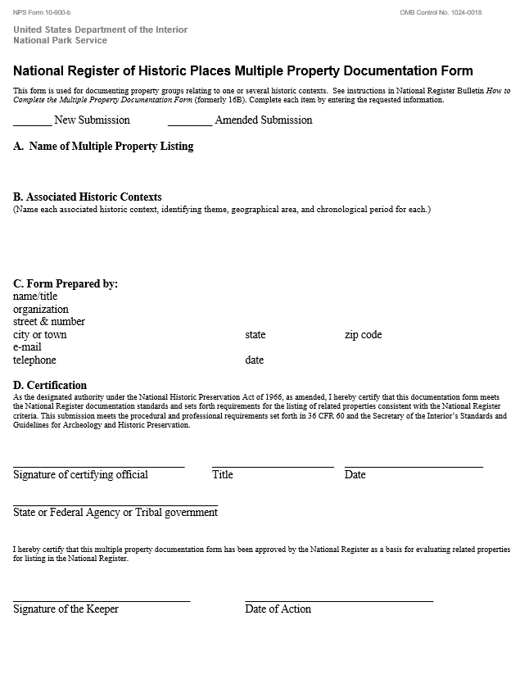
NRHP - Multiple Property Documentation Form – Oregon/Washington Interstate Bridges
Notes:
Image: Gears from the 1931 bridge incorporated into pedestrian railing of the new South Park Bridge. The bridge also recreates appearance of the original.

Slide 21
Project Agreement Consultation Schedule (Moving Forward)
Section 106 Consultation Meeting: July 14, 2021 (Today)
Draft of Project Agreement Stipulations to CPs: July 19, 2021
CP Comments on Proposed Agreement Stipulations due: August 16, 2021
Revised Stipulations and Whereas Statements to CPs: August 27, 2021
Section 106 Consultation Meeting: September 1, 2021
CP Comments on Revised Stipulations and Whereas Statements due: September 17, 2021
Complete Review Draft of Agreement to CPs for comment: October 1, 2021
Section 106 Consultation Meeting: October 8, 2021
Final CP comments on Agreement Review Draft due: October 29, 2021
Final Agreement out for review/signature: November 12, 2021
Notes:
Image: Gears from the 1931 bridge incorporated into pedestrian railing of the new South Park Bridge. The bridge also recreates appearance of the original.

Slide 22
For the Future
Next Steps
Action Items
Next Meeting Date (September 1, 2021)
Questions & Concerns

Slide 23
Adjourn

